Slide 1




THEATER TRANSFORMATION
TRUTH AND VISION MINISTRIES | S3 TECHNOLOGIES
Start Presentation
mys3tech.com
330-6498-5408

Slide 2
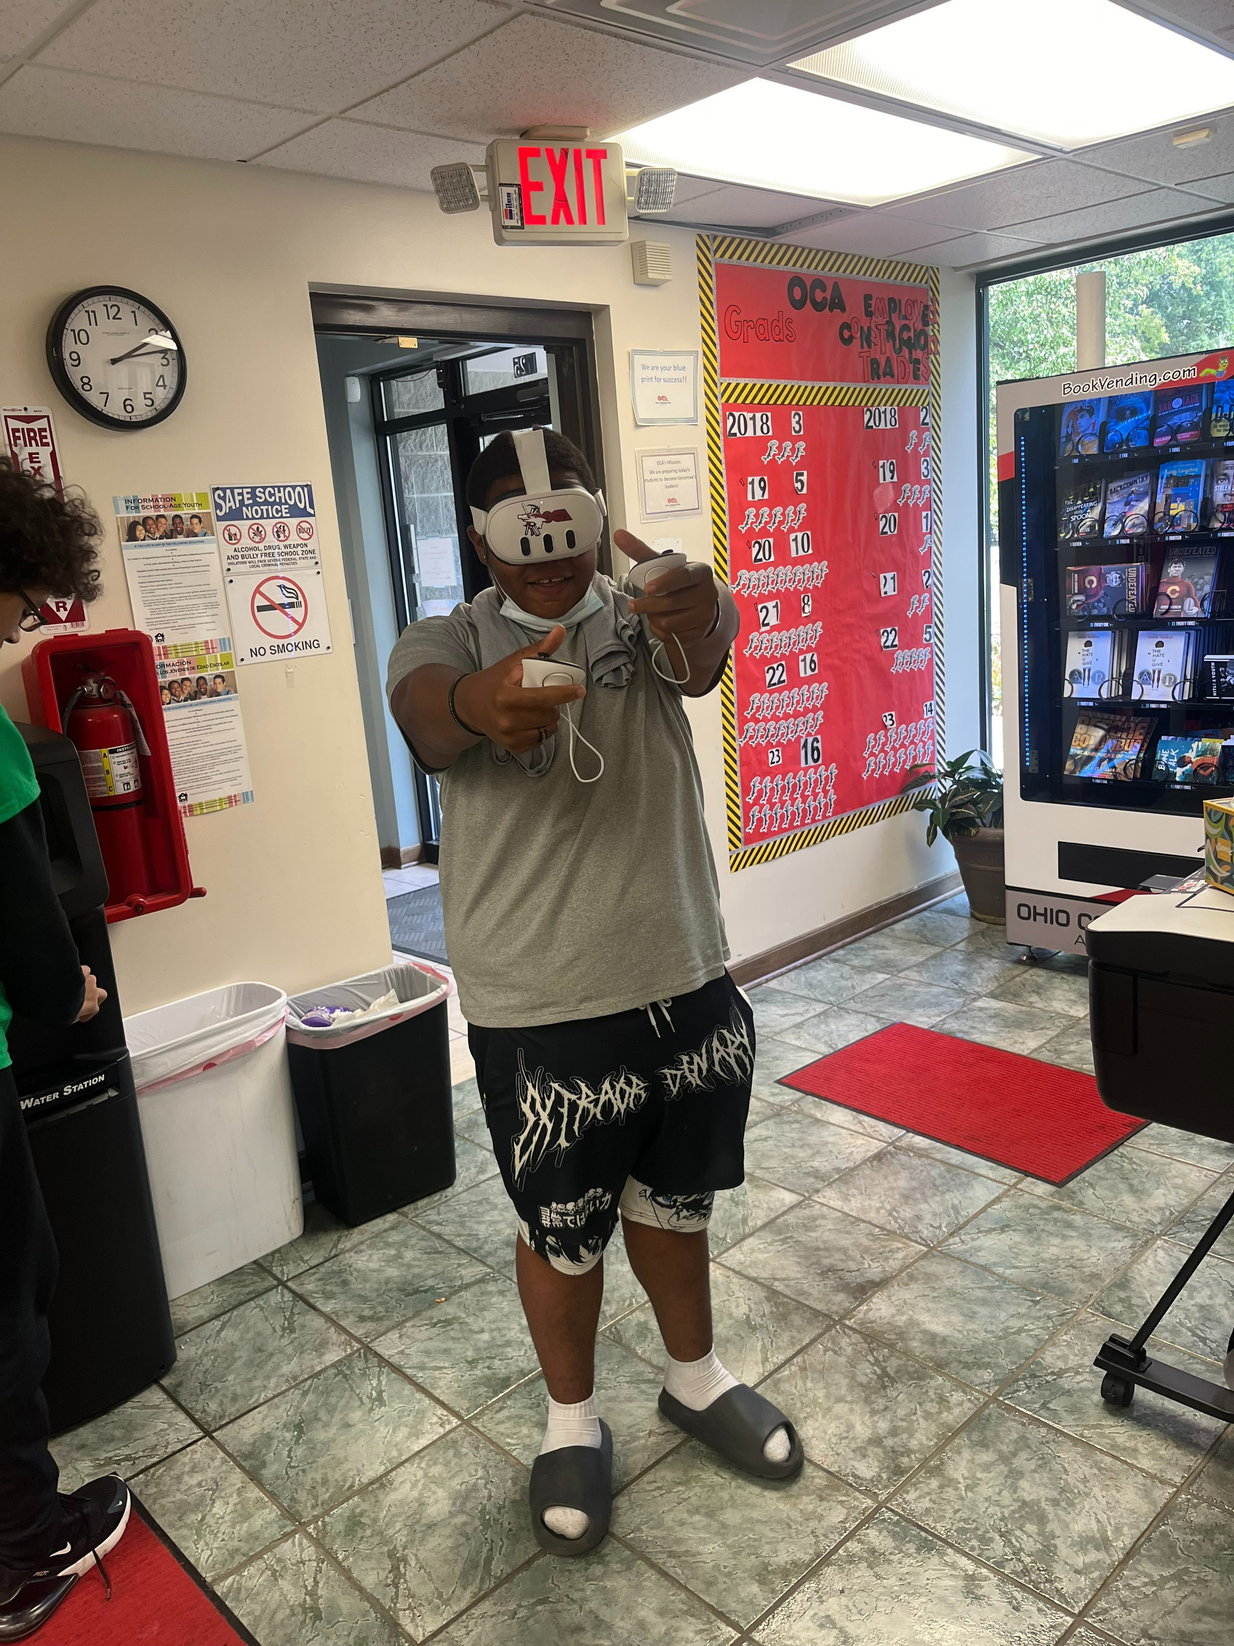
VISION STATEMENT
To create an innovative, multipurpose space where students can explore the intersection of technology and creativity through esports and a variety of immersive, hands-on emerging technologies.
This transformed space will empower students to learn real world technology skills, expose them to STEM career paths, and foster a sense of community and teamwork through esports.

Slide 3
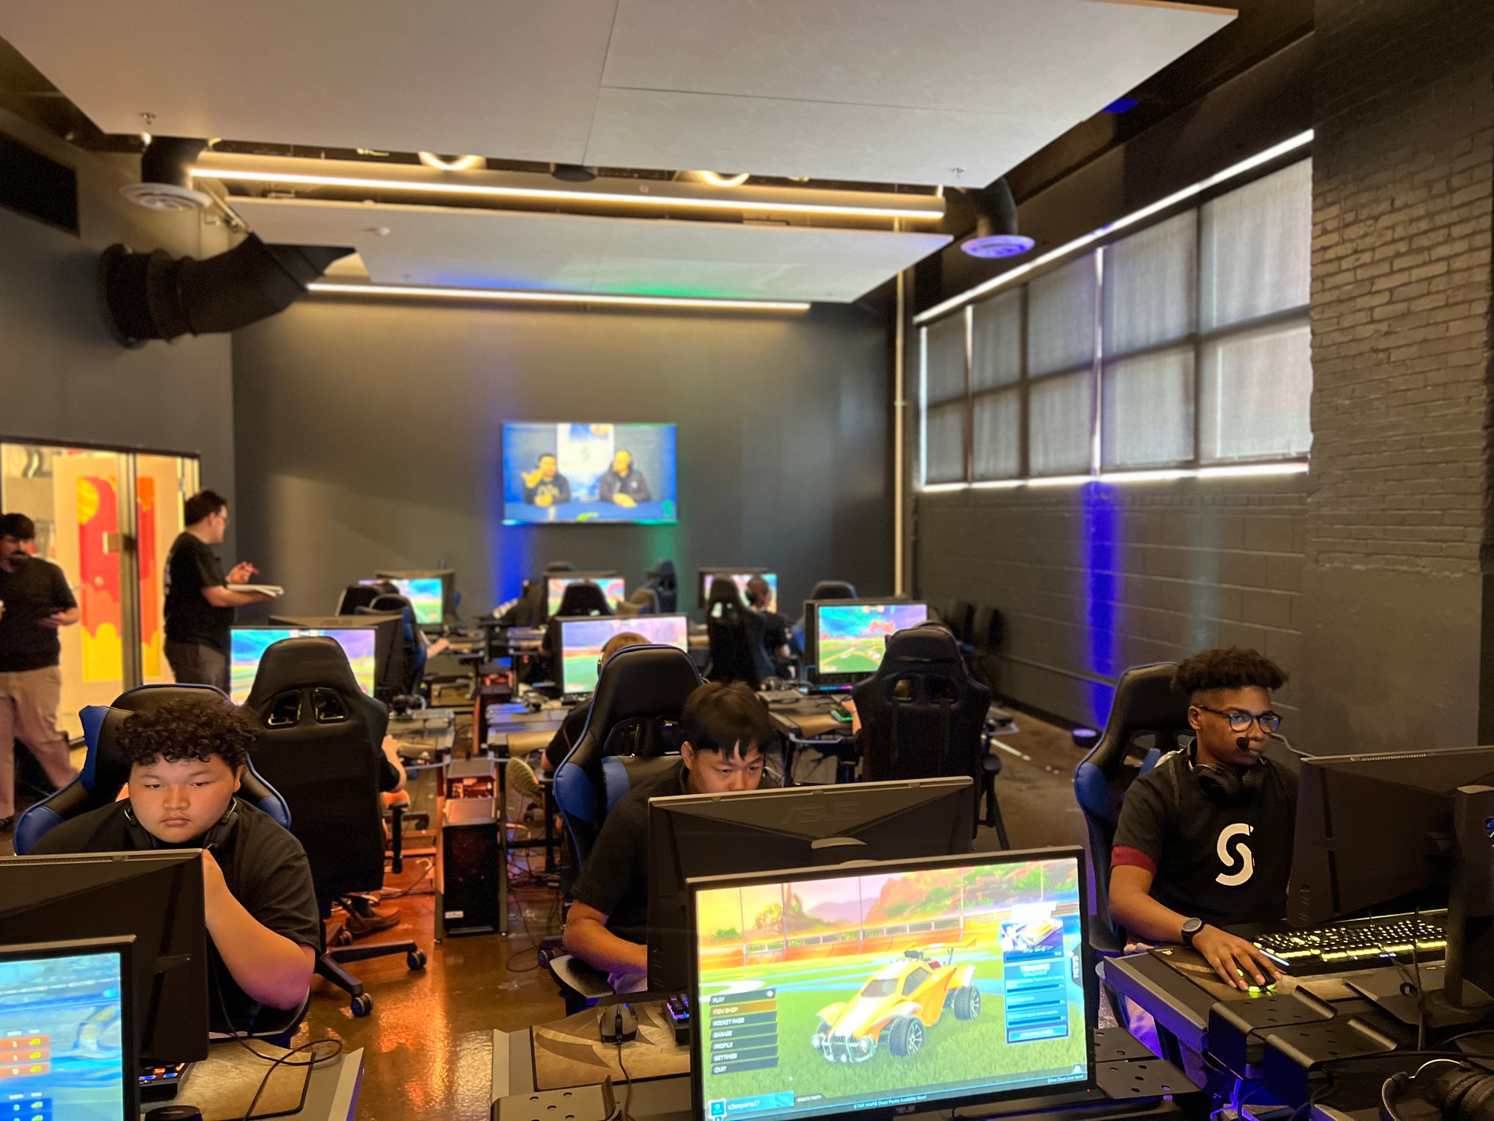
STEM HALL VISION
Phase 1 of this project focuses on transforming two areas: the hallway between theaters, and the smaller theater on the left. The hallway will become the STEM Hall: a space dedicated to a variety of interactive STEM-based technology.
Building a STEM afterschool space for students not only enhances their educational experience but also prepares them for future academic and career success, promotes diversity, and engages the community in meaningful ways.

Slide 4
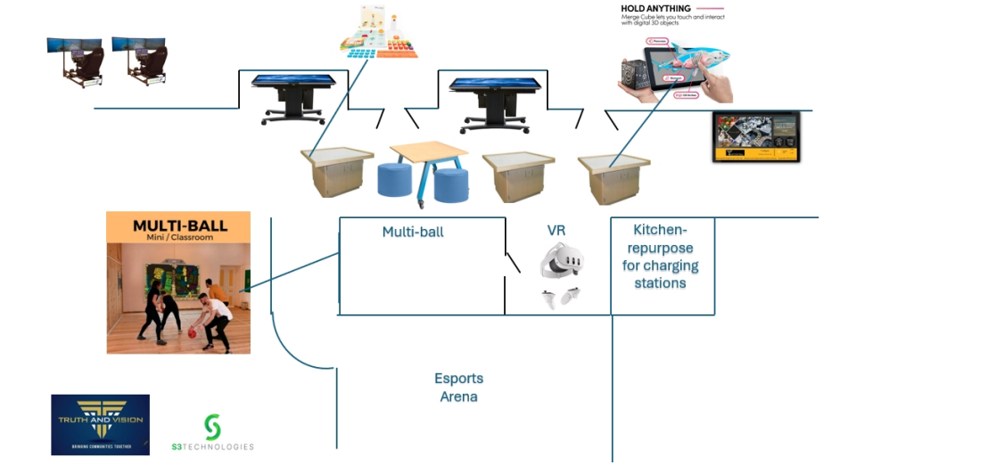
STEM HALL

Slide 5
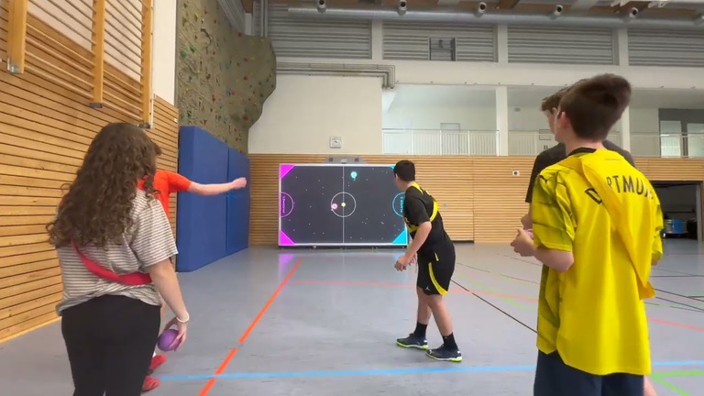
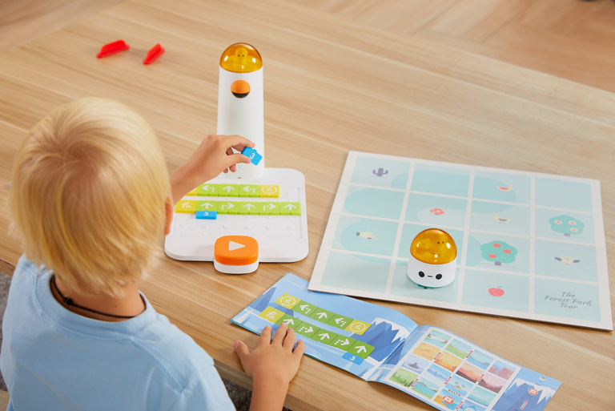
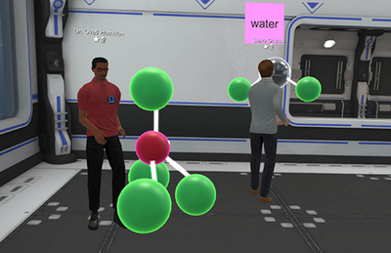
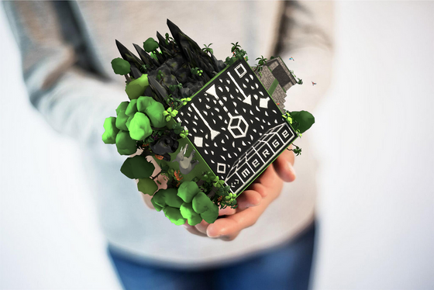
STEM HALL TECHNOLOGIES
Multiball Interactive Wall
4 Matatalab Coding Robots
Interactive projector that offers 40+ customizable games and apps for free. Great for improving hand-eye coordination!
Robot that can be programmed using physical blocks or a block coding app. Includes a booklet of challenge scenarios.
9 Meta Quest 3 VR Headsets and Victory XR
10 MERGE Cubes and AR Apps
A foam cube that uses Augmented Realilty to change into different objects that you can hold - especially useful for seeing detailed objects up close!
Immersive and educational Virtual Reality experiences that cover STEM focused subjects and topics.

Slide 6
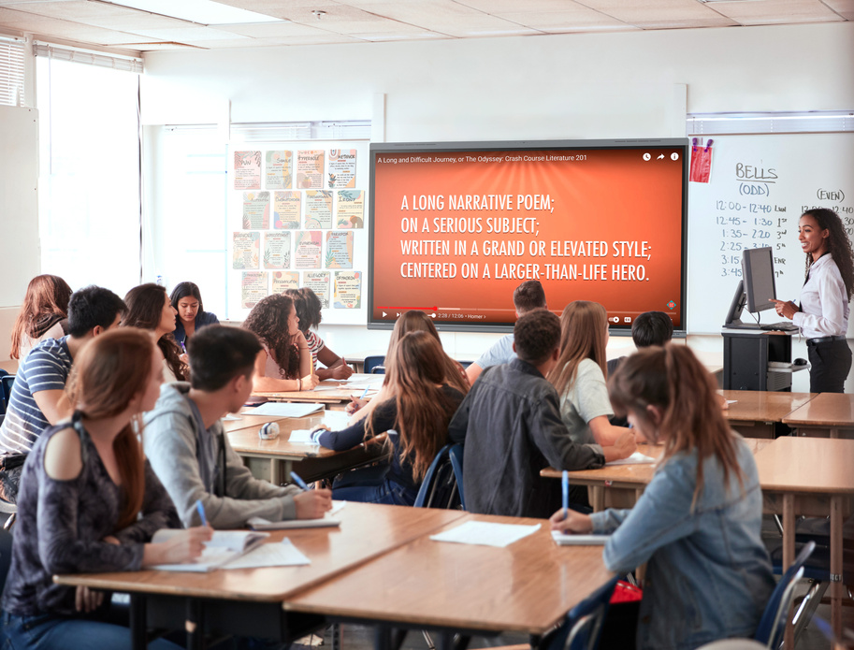
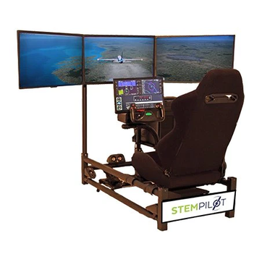
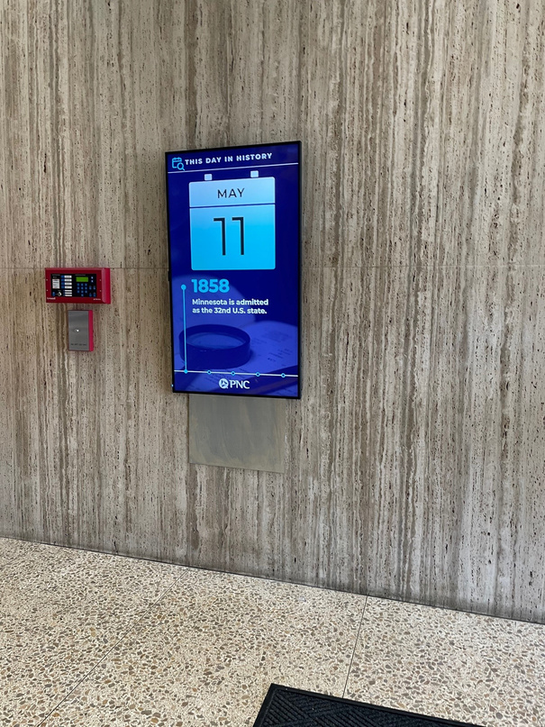
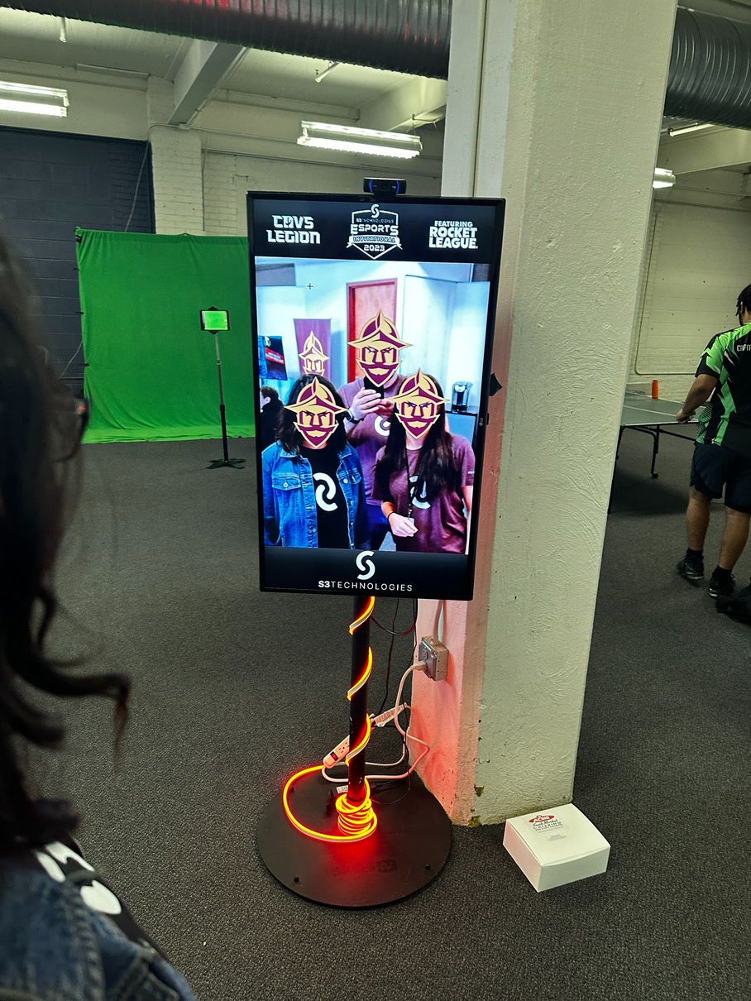
STEM HALL TECHNOLOGIES
2 Clear Touch Interactive Panels
2 Flight Simulators
Interactive touch panel that includes a whiteboard app, games, STEM based lessons, and other educational tools.
Sit-in simulator designed to replicate experience of flying an airplane. Includes a 3-screen display, pilot seat and controls, surround sound, and a PC.
2 Digital Signs with EngageS3
Augmented Reality Wall
Customizable digital signage program that can be used to display safety messaging, events calendar, announce visitors, and more.
A screen that takes a live camera feed and applies fun AR affects on top of the feed. Effects are customizable!

Slide 7
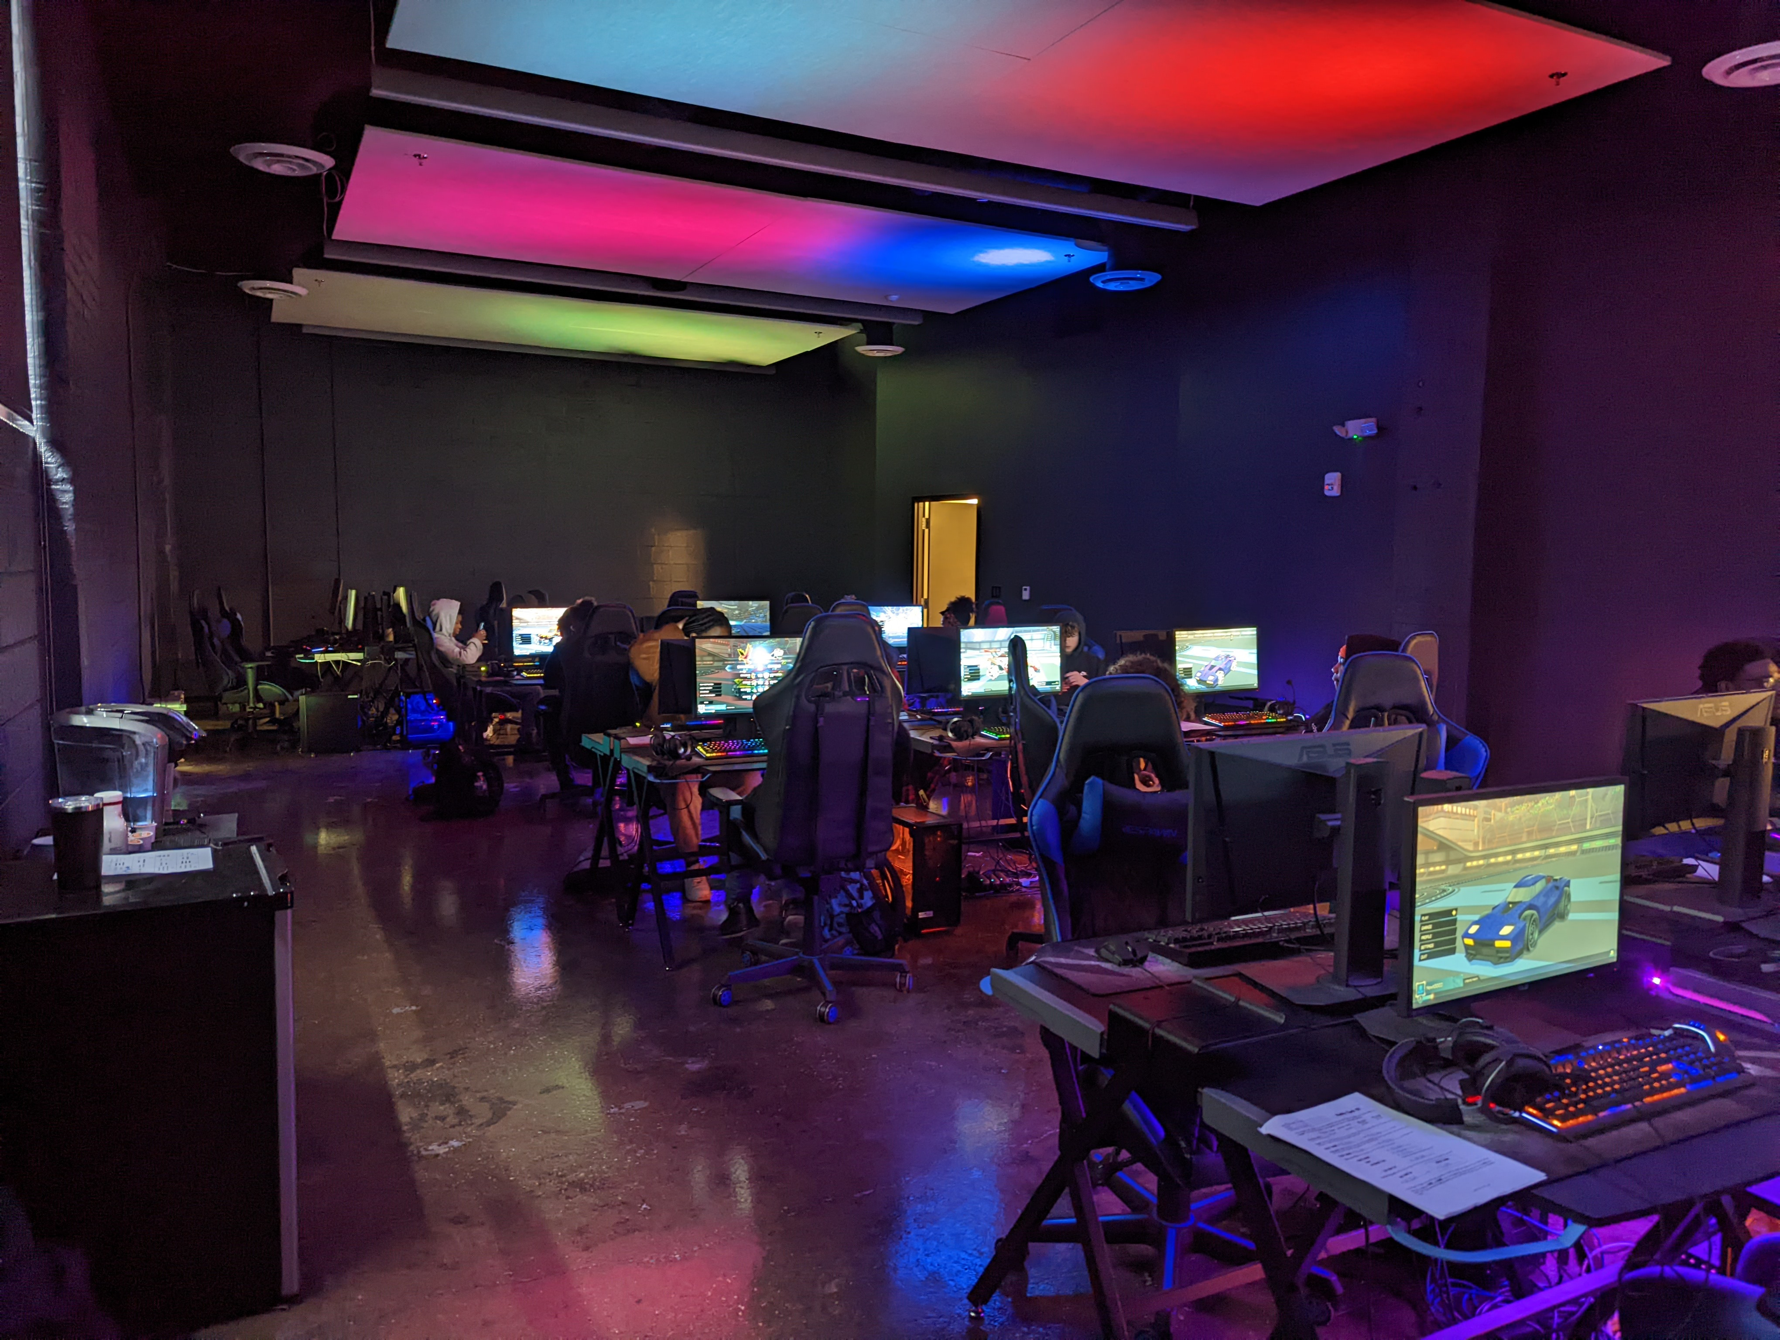
THEATER VISION
The smaller theater to the left of the entrance hall will be transformed into a multi-purpose room whose primary purpose will be to host esports tournaments. Professional video production equipment and graphics programs will be available for students to learn with.

Slide 8
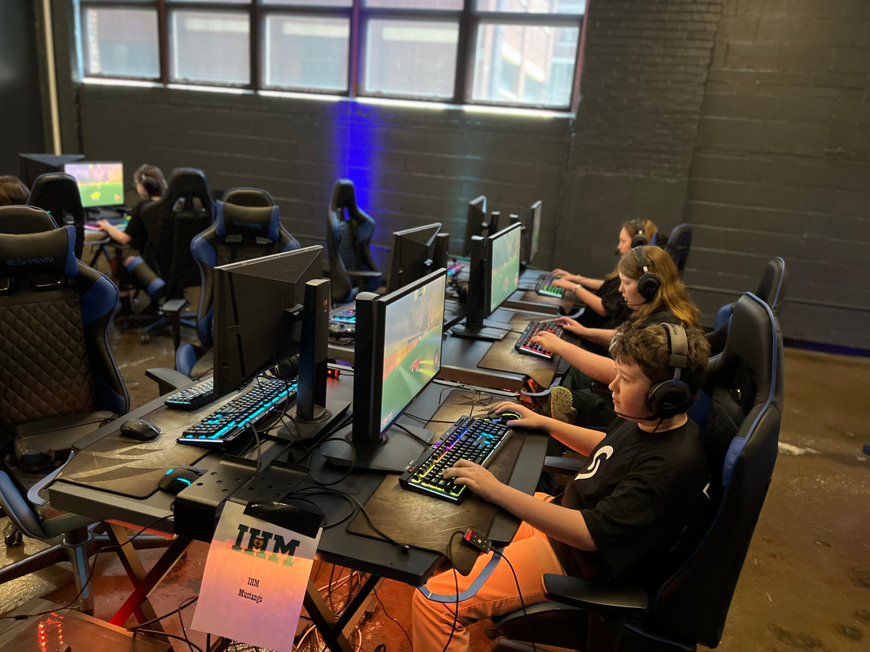
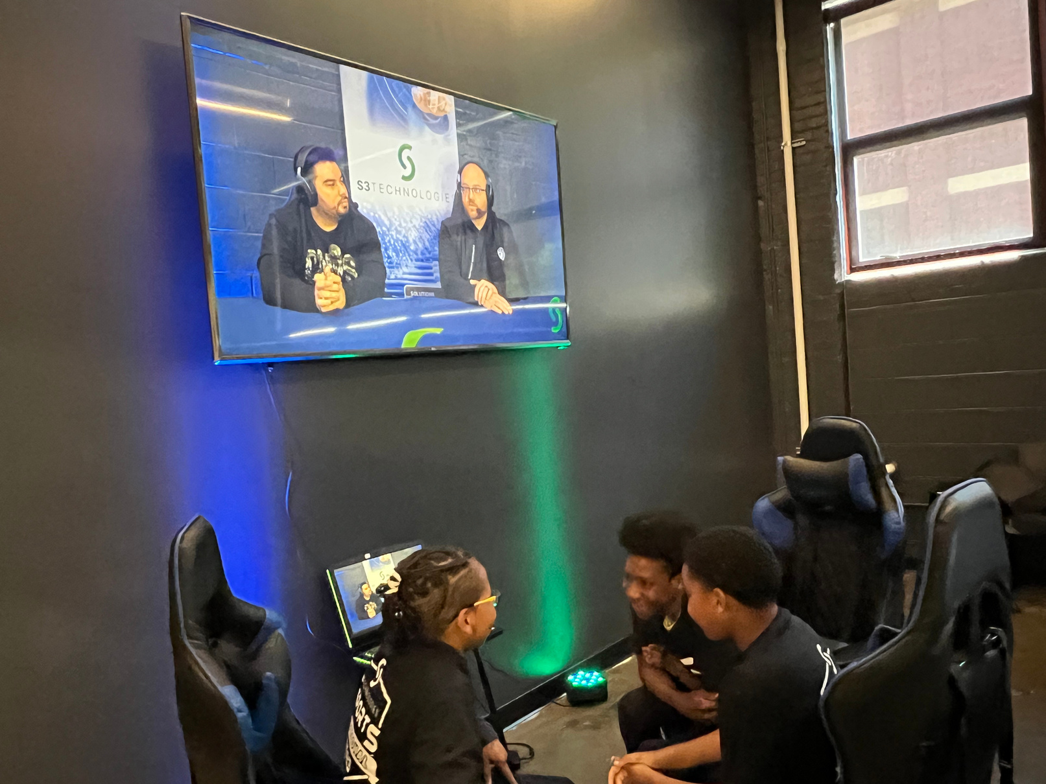
BENEFITS OF ESPORTS
Esports encourages many different positive behaviors and habits in kids who participate. Team games reward teamwork and collaboration, which fosters development of communication and problem solving skills.
Esports also removes participation barriers like age, gender, and able-bodiedness. Many games provide accessibility options for people with disabilities, including mappable controls, adaptive controllers, colorblind modes, screen reader support, subtitles, and more.

Slide 9
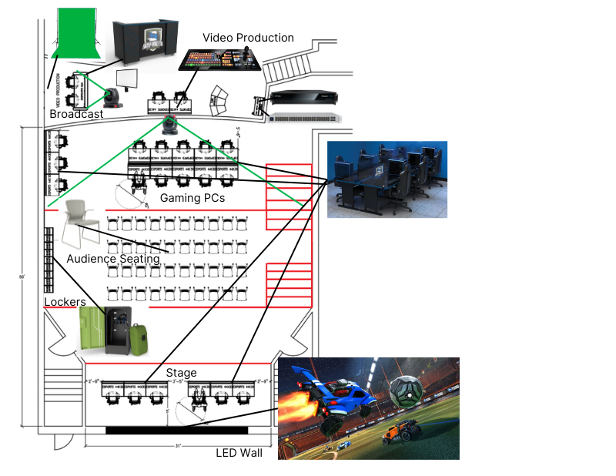
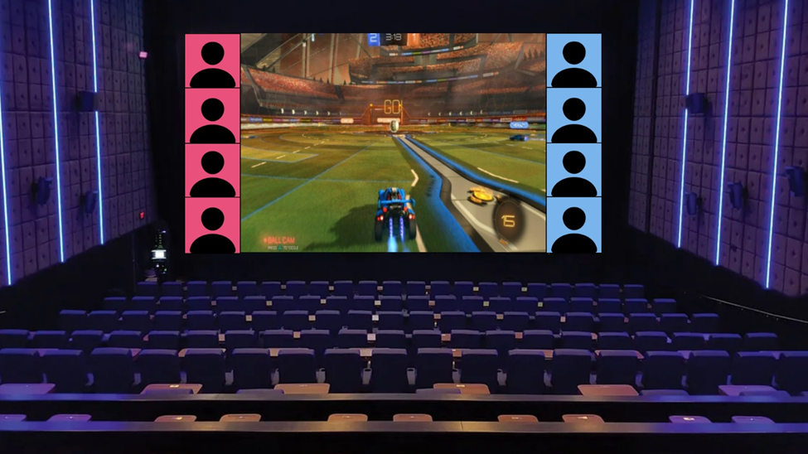
ESPORTS THEATER VISION
Two teams of 3 will be able to play on the stage, with gameplay displayed on the LED wall behind the stage.
Broadcasting and video production equipment will be in the back rooms behind the theater.

Slide 10
THANK YOU
FOR YOUR ATTENTION
Questions?

